Slide 1
Software DEVOLPMENT and Documentation

Slide 2
Project (25%): A comprehensive project where students document a sample software application, covering each SDLC phase.
Final Exam (75%)

Slide 3
Introduction
Reasons for software documentation
Types of software documentation
Ways to implement software documentation
Processes and “Good Ideas”

Slide 4
What is the Software documentation
is a written piece of text that is often accompanied by a software program. This makes the life of all the members associated with the project easier. It may contain anything from API documentation, build notes or just help content.
It is a very critical process in software development. It’s primarily an integral part of any computer code development method.
Moreover, computer code practitioners are a unit typically concerned with the worth, degree of usage, and quality of the actual documentation throughout the development and its maintenance throughout the total method.

Slide 5
Motivated by the requirements of Novatel opposition, a world-leading company developing package in support of worldwide navigation satellite system, and based mostly on the results of a former systematic mapping studies area unit aimed at a higher understanding of the usage and therefore the quality of varied technical documents throughout computer code development and their maintenance

Slide 6
For example, before the development of any software product requirements are documented which is called Software Requirement Specification (SRS). Requirement gathering is considered a stage of Software Development Life Cycle (SDLC).
Another example can be a user manual that a user refers to for installing, using, and providing maintenance to the software application/product.

Slide 7
Purpose of Documentation:
Due to the growing importance of computer code necessities, the method of crucial them needs to be effective to notice desired results. As to such determination of necessities is often beneath sure regulation and pointers that area unit core in getting a given goal.
These all imply that computer code necessities area unit expected to alter thanks to the ever ever-changing technology within the world.
However, the very fact that computer code information I’d obtained through development has to be modified within the wants of users and the transformation of the atmosphere area unit is inevitable.

Slide 8
What is more, computer code necessities ensure that there’s a verification and therefore the testing method, in conjunction with prototyping and conferences there are focus teams and observations?
For a software engineer reliable documentation is typically a should the presence of documentation helps keep track of all aspects of associate applications, and it improves the standard of wares, it’s the most focused area of unit development, maintenance, and information transfer to alternative developers.
Productive documentation can build info simply accessible, offer a restricted range of user entry purposes, facilitate new users to learn quickly, alter the merchandise and facilitate chopping out the price.

Slide 9
Importance of software documentation
For a programmer reliable documentation is always a must the presence keeps track of all aspects of an application and helps in keeping the software updated.

Slide 10
Principles of Software Documentation:
While writing or contributing into any software documentation, one must keep in mind the following set of 7-principles :

Slide 11
1. Write from reader’s point of view:
It’s important to keep in mind the targeted audience that will be learning, and working through the software’s documentation to understand and implement the fully functional robust software application and even the ones who will be learning for the purpose of using the software. So, while writing a documentation it becomes very crucial to use the simplest language & domain related specific languages and terminologies. The structure of the documentation should be organized in a clearly viewable, navigable and understandable format.
If there’s a lot of content, you can organize it in the glossary part at the end of the document.
List down synonyms, antonyms and difficult terminologies used.

Slide 12
2. Avoid unnecessary repetition:
While the idea of hyperlinking and backlinking may seem redundant at the moment, but it aids in avoiding the need of redundancy. The back-end database stores every piece of information as an individual unit and displays it in various different variety of context so redundancy at any point will not be maintainable and is considered a bad practice.

Slide 13
3. Avoid ambiguity:
Documentation contains a lot of information regarding the versatile functionalities of the software system, every part of it must be written with clear and precise knowledge while avoiding any conflicting information that might cause confusion to the reader. For example, if one terminology is used in different set of context than it must be explicitly defined what it means so to avoid any miscommunication. This aspect of the software documentation is very important to avoid any kind of conflicting knowledge between the stakeholders, developers and the maintainers.

Slide 14
4. Follow a certain standard organization:
In order to maintain the professionalism, accuracy, and precision of the document a certain set of principles must be followed taking reference from other software documentations that would aid in organizing and structuring the content of the documentation in a much productive and organized way.

Slide 15
5. Record a Rationale
Rationale contains a comprehensive understanding of why a certain design or development decision was made. This part of our documentation is written & maintained by the developer or the designer itself for justification and verification for later needs. Rationale can be mentioned in the start or the end of the document although typically, it’s in the start of the document.

Slide 16
6. Keep the documentation updated but to an extent
This principle applies to the maintainers of the documentation of the software, because updates are made to the software on frequent intervals. The updates may contain some bug fixes, new feature addition or previous functionality maintenance. The maintainer of the documentation must only add the valuable content and avoid anything that doesn’t fit and irrelevant for that particular time.

Slide 17
7. Review documentation
The documentation consists of too many web-pages collectively holding a large chunk of information that’s serving a sole purpose – educate and spread knowledge to anyone who is trying to understand or implement the software. While working with a lot of information it is important ta take feedback from senior architects and make any necessary changes aligning the documentation with its sole purpose depending on the type of documentation.

Slide 18
Advantages of software documentation
The presence of documentation helps in keeping the track of all aspects of an application and also improves the quality of the software product.
The main focus is based on the development, maintenance, and knowledge transfer to other developers.
Helps development teams during development.
Helps end-users in using the product.
Improves overall quality of software product
It cuts down duplicative work.
Makes easier to understand code.
Helps in establishing internal coordination in work.

Slide 19
Disadvantages of software documentation
The documenting code is time-consuming.
The software development process often takes place under time pressure, due to which many times the documentation updates don’t match the updated code.
The documentation has no influence on the performance of an application.
Documenting is not so fun, it’s sometimes boring to a certain extent.
The agile methodology encourages engineering groups to invariably concentrate on delivering prices to their customers. This key should be thought-about within the method of manufacturing computer code

Slide 20
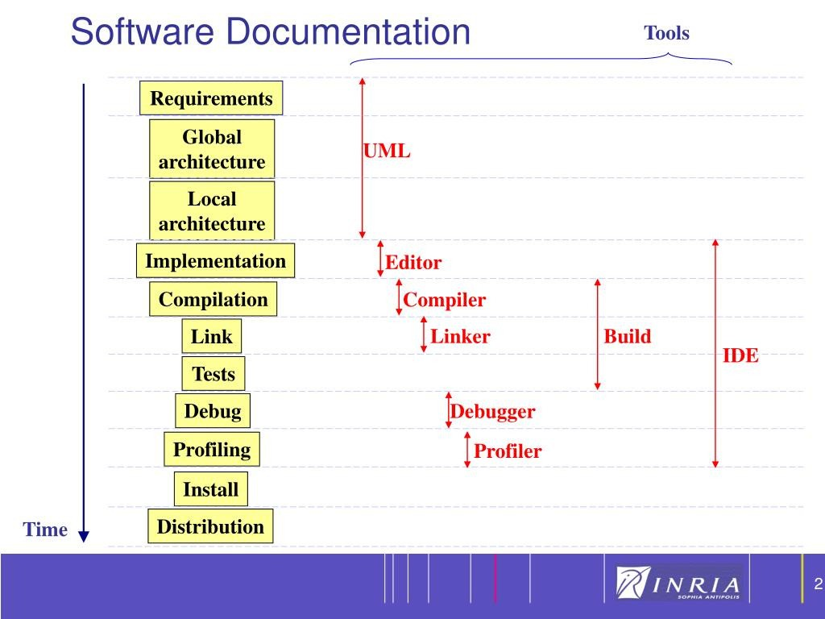

Slide 21


Slide 22
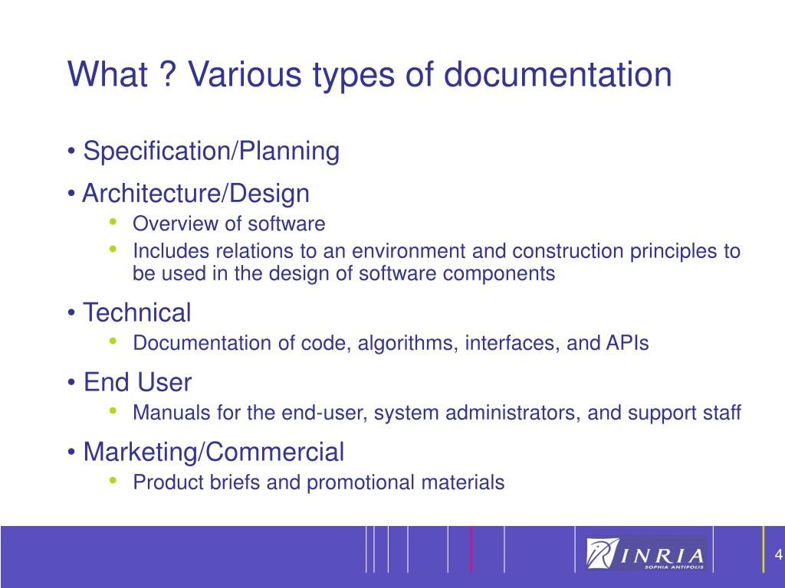

Slide 23
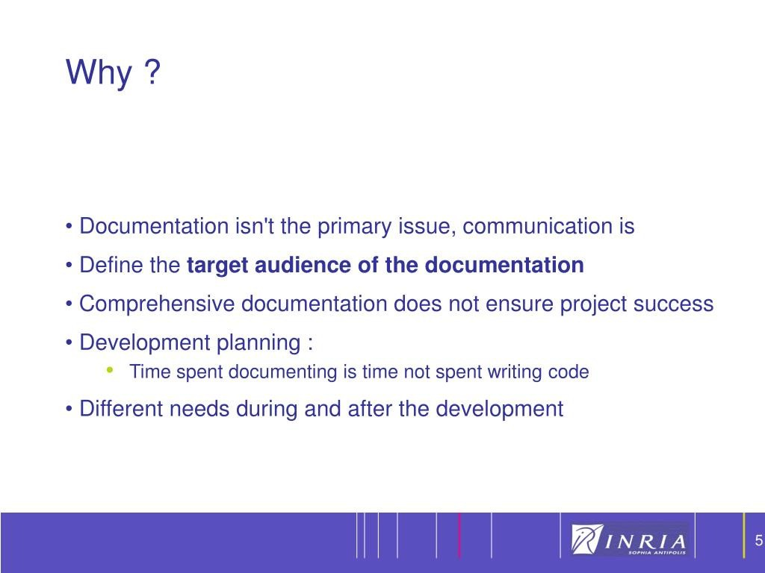

Slide 24
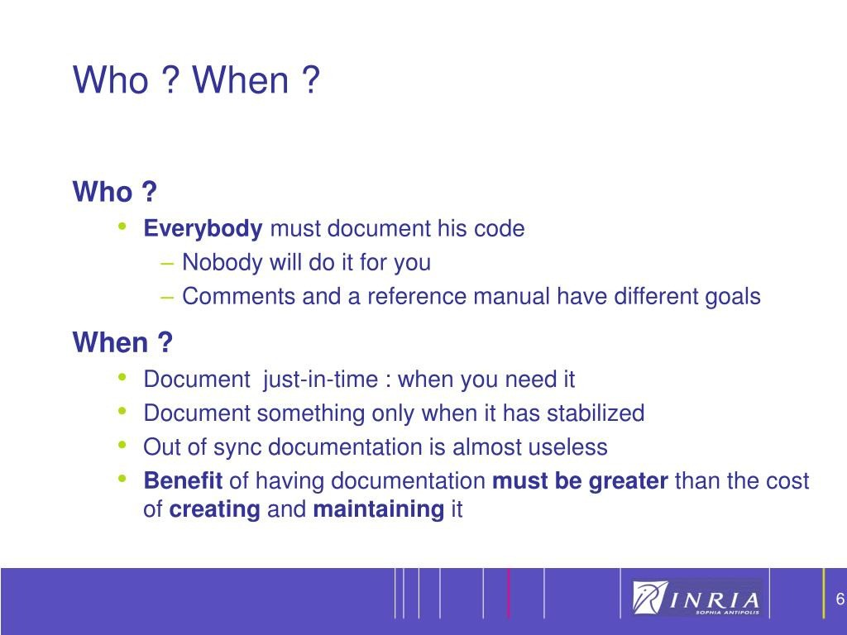

Slide 25
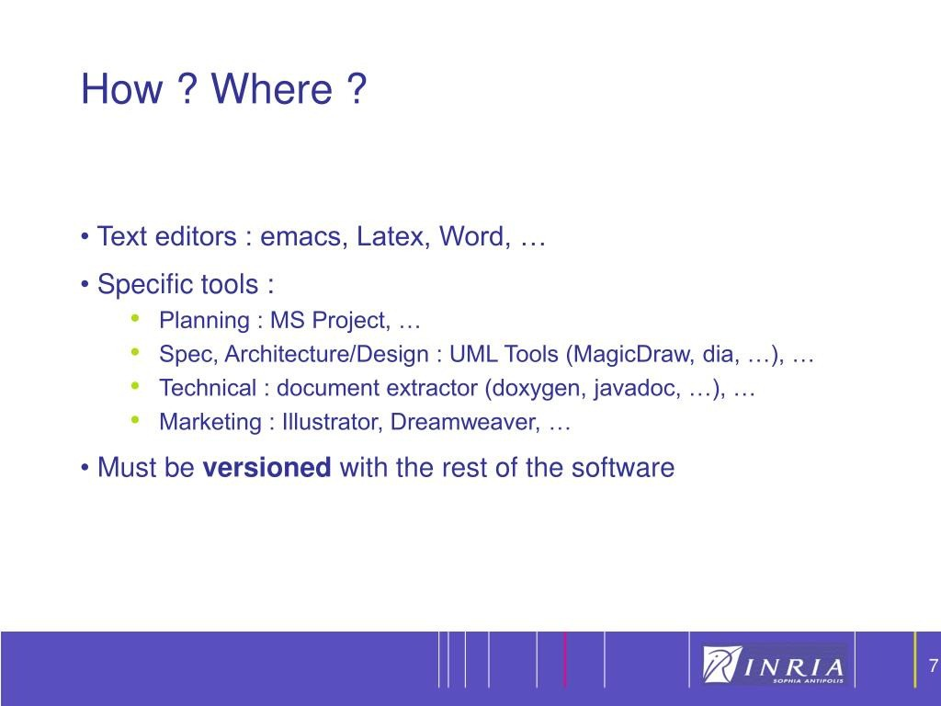

Slide 26
